Slide 1
QC steps of GWAS tutorial
Theory behind it and command breakdown
Dr. K. Sangeetha
Email: k26sangeetha@gmail.com
LinkedIn:linkedin.com/in/dr-sangeetha-kannan-08217883

Slide 2
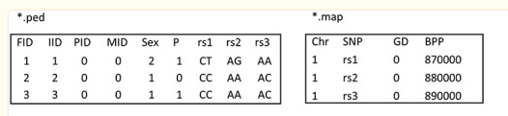
Data format (for PLINK)
PLINK can either read txt format files or Binary files
Text files are large and reading them can be time consuming
Use of Binary files is recommended
Text Plink data files
*.ped: contains information on individuals and their genotypes
*.map: information on genetic markers

Slide 3
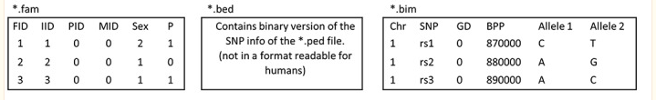
…data format for PLINK
Binary PLINK data contains three files:
*.bed: File containing individual identifiers (IDs) and genotypes
*.fam: Text file with information on individuals
*.bim: Text file with information on genetic markers
In the study of bipolar disorder
*.bed file contain the genotyping results of all patients and healthy controls
*.fam file contain the subject‐related data (family relationship with other participants in the study, sex, and clinical diagnosis)
*.bim file contain information on physical position of SNPs.

Slide 4
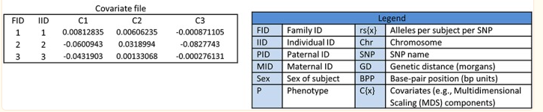
…data format for PLINK
Analysis using covariates often requires a fourth file, containing the values of these covariates for each individual

Slide 5
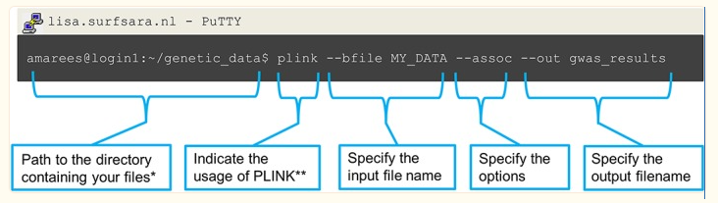
Understanding basic PLINK command
PLINK is a command line program; hence, its usage requires an active shell waiting for commands. This can be recognized by its prompt ($ or >) just before the cursor.

Slide 6
QC step 1: Excluding missingness of SNPs and individuals
Command | Function | Thresholds and explanation
‐‐geno | Excludes SNPs that are missing in a large proportion of the subjects. In this step, SNPs with low genotype calls are removed. | First filter SNPs and individuals based on a relaxed threshold (0.2; >20%), as this will filter out SNPs and individuals with very high levels of missingness. Then a filter with a more stringent threshold can be applied (0.02). Note, SNP filtering should be performed before individual filtering
‐‐mind | Excludes individuals who have high rates of genotype missingness. In this step, individual with low genotype calls are removed.

Slide 7
Sex discrepancy
2: Sex discrepancy | ‐‐check‐sex | Checks for discrepancies between sex of the individuals recorded in the dataset and their sex based on X chromosome heterozygosity/homozygosity rates | Helps identify sample mix‐ups. Males should have an X chromosome homozygosity estimate >0.8 and females should have a value <0.2
Sometimes sample mis-labelling can occur, which may lead to invalid results
Difference between reported sex and that indicated may be due to a difference in gender identity or also reflect mislabeling of samples and are typically removed
A sex check can be performed in PLINK, in which individuals are called as females if their X chromosome homozygosity estimate (F statistic) is < 0.2 and as males if the estimate is > 0.8.
Note:The F-test sums the predictive power of all independent variables, large F ratio means that the variation among group means is more than you'd expect to see by chance

Slide 8
Heterozygosity rate refers to the proportion of positions in a genome where an individual has two different alleles (variants of a gene). In a GWAS, QC tests are used to ensure the quality and reliability of the data. One such QC test is the heterozygosity rate test, which is used to identify and exclude samples with abnormal heterozygosity rates, as these may be indicative of technical issues or genotyping errors.

Slide 9
Cryptic relatedness
Cryptic relatedness refers to the phenomenon in which two individuals appear to be unrelated, but in fact share a common ancestor. This can occur when a genealogy or family tree is incomplete, or when two individuals have a common ancestor that is many generations back and not easily discernible from their current genealogical records
Cryptic relatedness can be a problem in genetic studies, because it can lead to confounding results when researchers fail to account for it
For example, if two individuals who are cryptically related are included in a study as unrelated controls, their genetic similarities may artificially inflate the results, leading to false conclusions about the effects of a particular genetic variant

Slide 10
IBD (identity-by-descent) estimation is a way to detect and quantify cryptic relatedness among study participants
What is IBD estimation methods
Uses the genotype data from the GWAS to infer the probability the pair of individuals share segment of their genome that are identical by descent (IBD) by measuring IBD probabilities
Once estimated, the IBD probabilities can be used to correct the inflation of test statistics caused by cryptic relatedness by removing or adjusting the relatedness using methods such as genomic control
PI-hat value is a measure of linkage disequilibrium (LD) between a single nucleotide polymorphism (SNP). A PI-hat value of 0.2 or greater indicates that the SNP is in strong LD with at least one other marker in the genome.

Slide 11
Command Breakdown: Step 1 of QC step 6
This step compute IBD estimates using genome flag by setting pihat at min 0.2. It helps to identify the pair of individuals that are related
./plink --noweb --bfile HapMap_3_r3_10 --extract indepSNP.prune.in --genome --min 0.2 --out pihat_min0.2
The --genome option enables IBD estimation using binary plink file input (--bfile file_name)
The --min option sets the pi-hat threshold to 0.2, meaning that only pairs of individuals with a pi-hat value greater than or equal to 0.2 will be included in the output file, to identify related individuals in the study sample
The prune.in file is used to extract the variants that passed the pruning criteria.
The output will be saved in a file named “pihat_min0.2.genome" and you can find the dataset there
Additionally, --noweb options helps to suppress additional text/output during the process

Slide 12
Command Breakdown: Step 2 of QC step 6
The step is to create a file ‘zoom_pihat.genome’, which contains only the lines from the ‘pihat_min0.2.genome’ file where the value in the Z1 field is greater than 0.9
Individuals with Z1 value > 0.9 suggests that the genetic variant (SNPs) in question is likely to be transmitted from parents to offspring and is associated with the trait of interest with high significance
awk '{ if ($8 >0.9) print $0 }' pihat_min0.2.genome>zoom_pihat.genome
The awk utility uses the condition $8 >0.9 to select only the lines where the value of 8th field (Z1) is greater than 0.9
The ‘{print $0}’ action prints the selected lines to the standard output
The standard output is redirected to the ‘zoom_pihat.genome’ file using the > operator

Slide 13
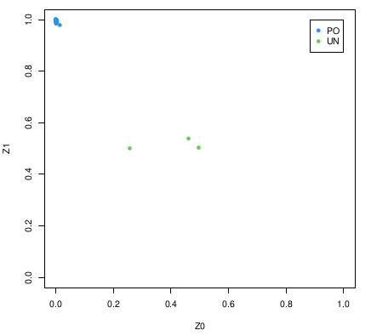
Command Breakdown: Step 3 of QC step 6
Generate a plot to assess the type of cryptic relationship using the command Rscript --no-save Relatedness.R to show amount of related individuals (PO = parent-offspring, UN = unrelated individuals) for a the Hapmap data that contains a parent offspring relationship?
Using the Z0 and Z1 as variables, a scatter plot is generated as output to represent relatedness between parent and offspring
The IBD values closer to 1 show individuals more likely to be related as parent-offspring
The PO individuals are clustered together on the top left corner of the diagonal line showing a strong positive correlation between the Z0 and Z, suggesting they are likely parent-offspring pairs

Slide 14
Command Breakdown: Step 4 of QC step 6
This command pick only founders from the HapMap_3_r3_10 file to remove all relatedness from the dataset and therefore exclude those individuals who are related as parent-offspring in the output HapMap_3_r3_11 file
./plink --noweb --bfile HapMap_3_r3_10 --filter-founders --make-bed --out HapMap_3_r3_11
Founders typically refer to individuals who are the first members of a breeding population. These individuals are used to establish a breeding colony, and their genetic characteristics are passed on to subsequent generations through reproduction.
Non-founders are individuals who are not part of the initial group of founders, but are instead derived from the founder population through reproduction
Picking only founders for a genome-wide association study (GWAS) can prevent the selection of parent-offspring related individuals. This is because the founders represent a diverse group of individuals with distinct genetic backgrounds, while parent-offspring related individuals are more likely to share similar genetic characteristics
By restricting the study population to founders, researchers can reduce the risk of identifying false positive associations, which can occur when the study population includes parent-offspring related individuals

Slide 15
Command Breakdown: Step 5 of QC step 6
This step identifies related individuals with pi-hat>0.2 that remained in the HapMap_3_r3_11 file to exclude all non-founders (only one such individual pair was found)
./plink --noweb --bfile HapMap_3_r3_11 --extract indepSNP.prune.in --genome --min 0.2 --out pihat_min0.2_in_founders
A full sib pair is a pair of individuals who share both of their biological parents, and thus have on average 50% of their genome in common. DZ (dizygotic) twin pair refers to a pair of twins that are not identical and are formed from separate fertilized eggs, They share on average 50% of their genome like any sibling. Z-scores are values that indicate how many standard deviations a given value is from the mean of a dataset. In the context of a non-founder individual pair, Z-scores can be used to compare their genetic similarity to the average similarity of other pairs in the dataset.

Slide 16
A z1 value greater than 3 is generally considered as statistically significant

